Slide 1

“Employee Management System”
Tuljaram Chaturchand College of Arts, Science and Commerce
Baramati
PROJECT TITLE
PROJECT GUIDE:
Prof. N.H. Shaikh
SUBMITTED BY:
TEJAS. R. SHINDE [13214]
TEJAS. S. TAWARE[13217]

Slide 2
INTRODUCTION
The Employee Management System is a comprehensive software solution designed to streamline and automate the processes related to managing employees within an organization. It aims to enhance efficiency, accuracy, and productivity by digitizing and centralizing employee information, HR tasks, and administrative procedures.
The system offers a user-friendly interface accessible to HR personnel and employees, facilitating seamless collaboration and communication across the organization. The system provides a centralized employee database to store and manage comprehensive information about each employee, including personal details, employment history, skills, qualifications, and performance records. It ensures data accuracy and eliminates manual paperwork.

Slide 3
SCOPE OF SYSTEM
The scope of the Employee Management System includes the following key aspects:
Employee Information Management: The system will capture and store comprehensive employee information, including personal details, contact information, employment history, skills, certifications, performance records, and other relevant data.
Design of an HR management: system to meet needs such as adding and deleting employees, viewing and printing employee data, and updating employee information. Employee data is stored in a well-designed database. An easy-to-use interface that will let user interact with the system.

Slide 4
EXISTING SYSTEM
The existing system for Employee Management typically involves manual and paper-based processes, which can be time-consuming, error-prone, and inefficient.
Manual Data Entry: Employee information is often stored in physical files or spreadsheets, requiring manual data entry and updating.
Limited Accessibility: Access to employee data and information is restricted to specific individuals or departments, leading to delays in retrieving necessary information and reducing collaboration across the organization.
Security and Data Privacy Concerns: Storing employee information in physical files or scattered spreadsheets can lead to security risks and potential data breaches.

Slide 5
PROPOSED SYSTEM
Centralized Employee Database: The system will have a centralized database to store and manage employee information, including personal details, employment history, skills, qualifications, and performance records. It will ensure data integrity, reduce duplication, and enable easy access and updates.
User-Friendly Interface: The system will have an intuitive and user-friendly interface accessible to HR personnel, managers, and employees. It will provide role-based access, allowing users to view and update relevant information while maintaining data privacy and security.
By implementing the proposed Employee Management System, organizations will benefit from increased efficiency, improved data accuracy, streamlined processes, enhanced communication, and better employee engagement.

Slide 6
MODULES
Multiple user access: Allows multiple type users teachers/student/admin) to login
Functional Admin panel: Allows admins to manage the whole system
CRUD functionalities: Allows admin to create, read, update and delete their employee data in a managed format
Profile update option: Allows admin to update their employee account details
Secure registration and login option for admin
Allows admin to search, update, print, view their employees’ details easily.

Slide 7
HARDWARE REQUIREMENT
Processor: Intel I3 2.8 GHz Processor and Above
RAM 4 GB and Above
Operative Memory required for the software MB
500 MB of free disk space for Eclipse installation
Additional disk space for your projects and any additional plugins or extensions

Slide 8
SOFTWARE REQUIREMENT
Operating System: WINDOWS OS (Windows 7, 8,10,11) Or Linux
Frontend: Java, Swing [Java Foundation Classes] [JFC] library and an extension of the Abstract Window Toolkit [AWT].
Backend: MySQL, JDBC[For Database Connectivity].
Integrated Development Environment (IDE): for Java development include Eclipse, IntelliJ IDEA, and NetBeans.

Slide 9
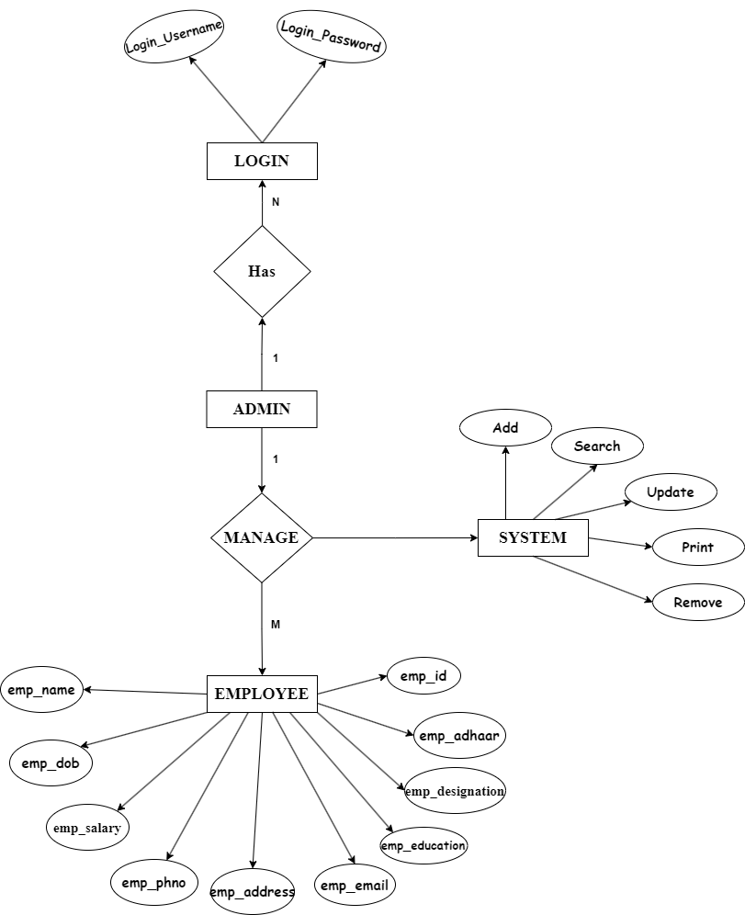
ER-DIAGRAM

Slide 10
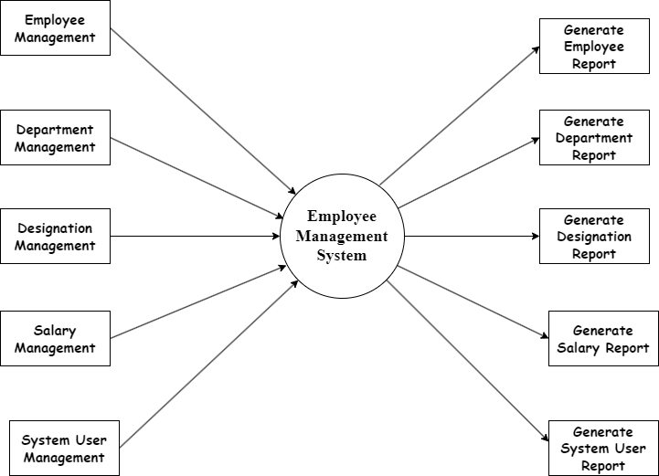
DFD LEVEL - 1

Slide 11
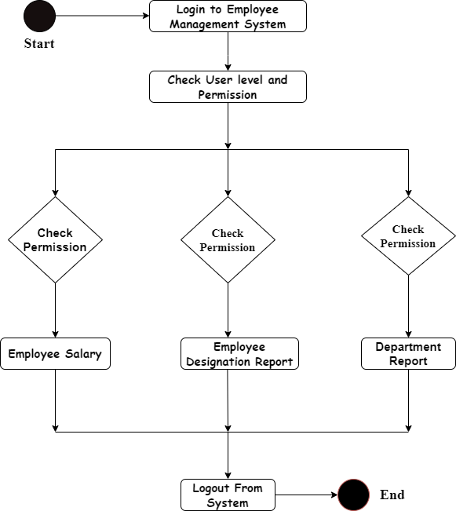
ACTIVITY DIAGRAM

Slide 12
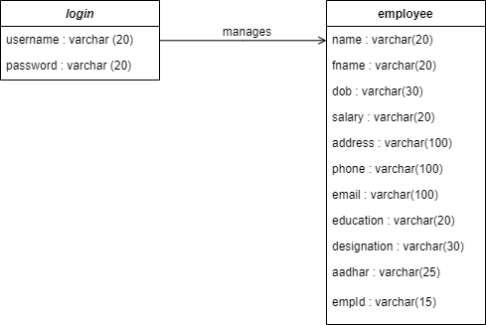
CLASS DIAGRAM

Slide 13
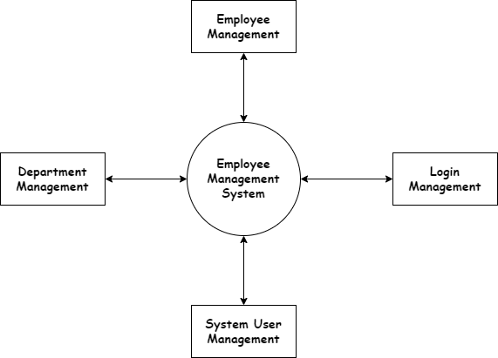
DFD LEVEL - 0

Slide 14
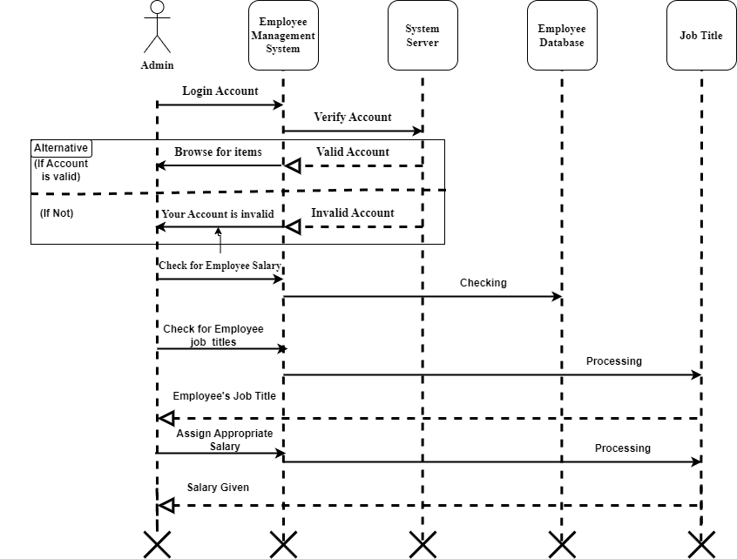
SEQUENCE DIAGRAM

Slide 15
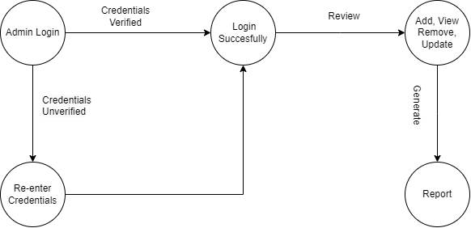
STATE CHART

Slide 16
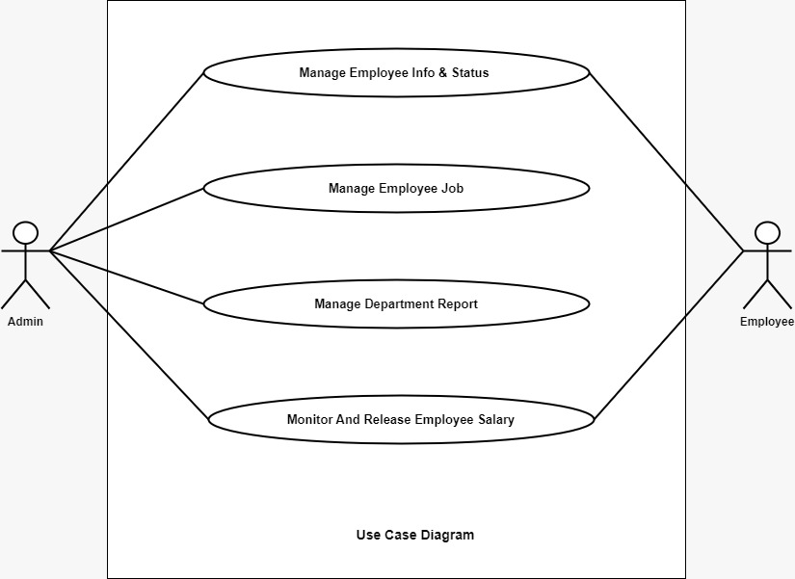
USE-CASE DIAGRAM

Slide 17
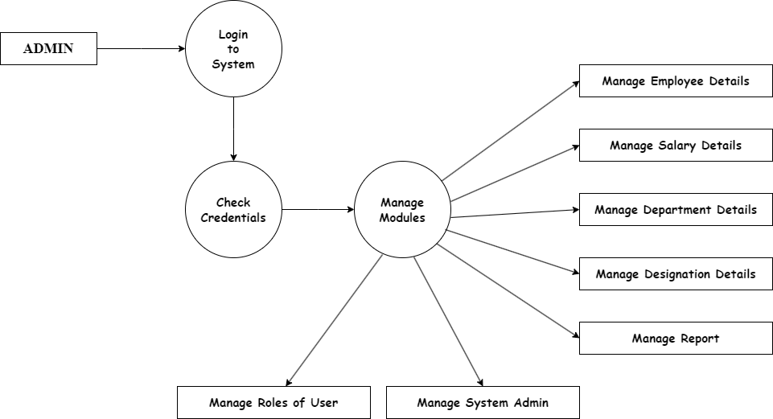
DFD LEVEL - 2

Slide 18
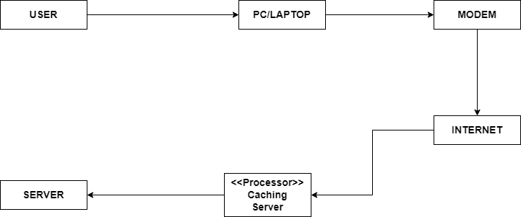
DEPLOYMENT DIAGRAM

Slide 19
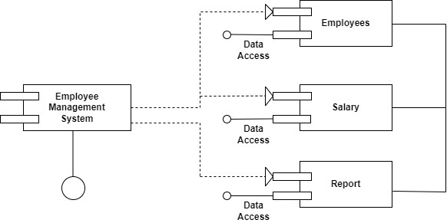
COMPONENT DIAGRAM

Slide 20
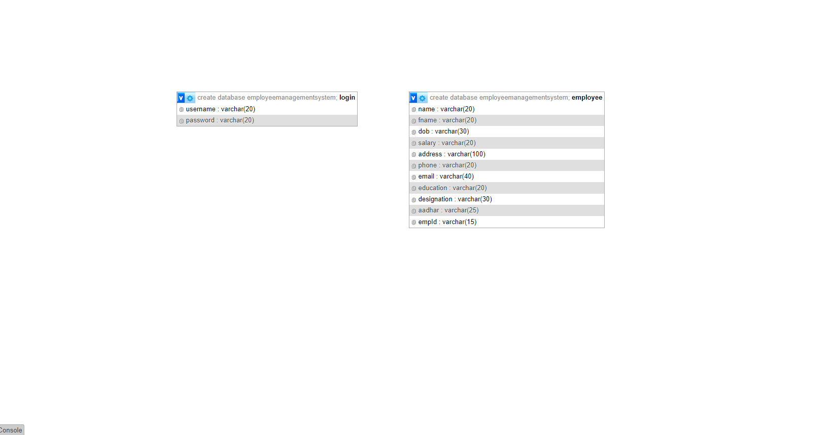
DATA DICTIONARY

Slide 21

HOMEPAGE

Slide 22
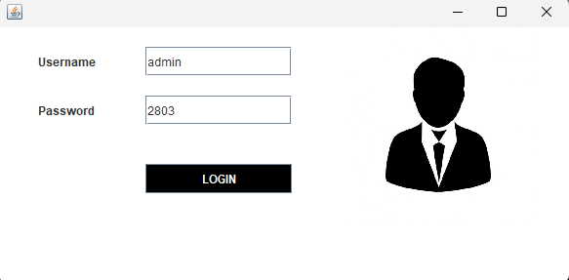
LOGIN FORM

Slide 23
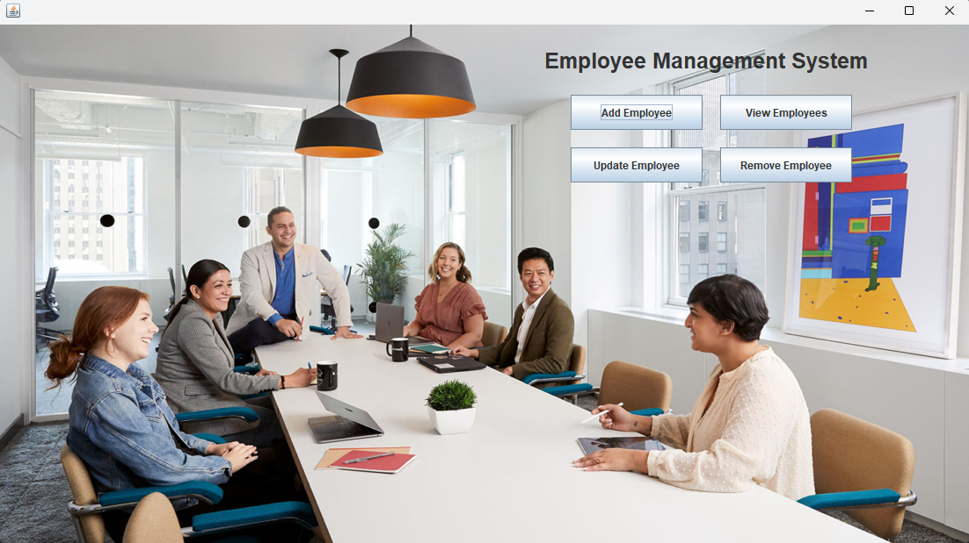
DASHBOARD

Slide 24
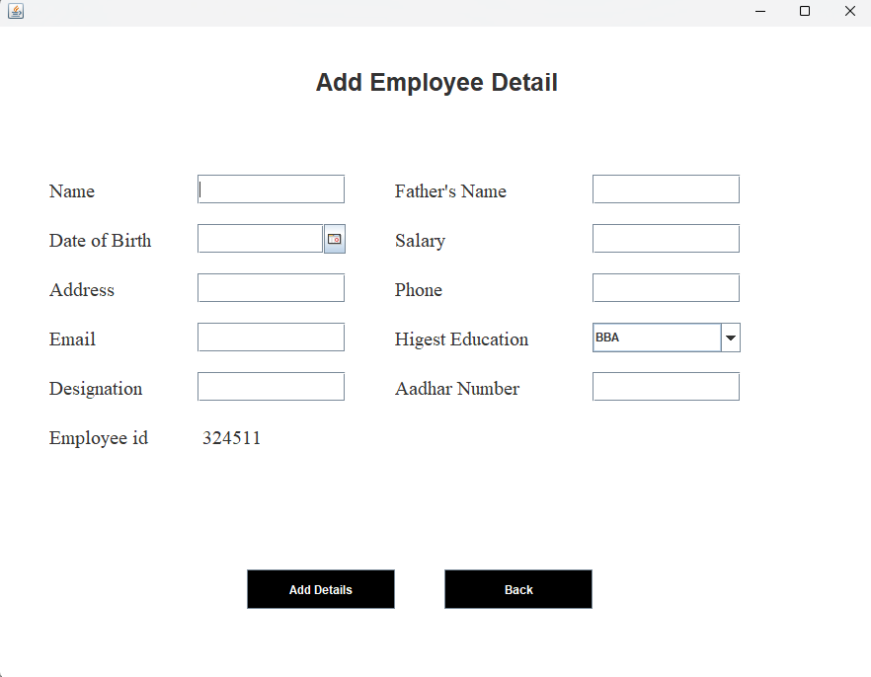
REGISTRATION FORM

Slide 25
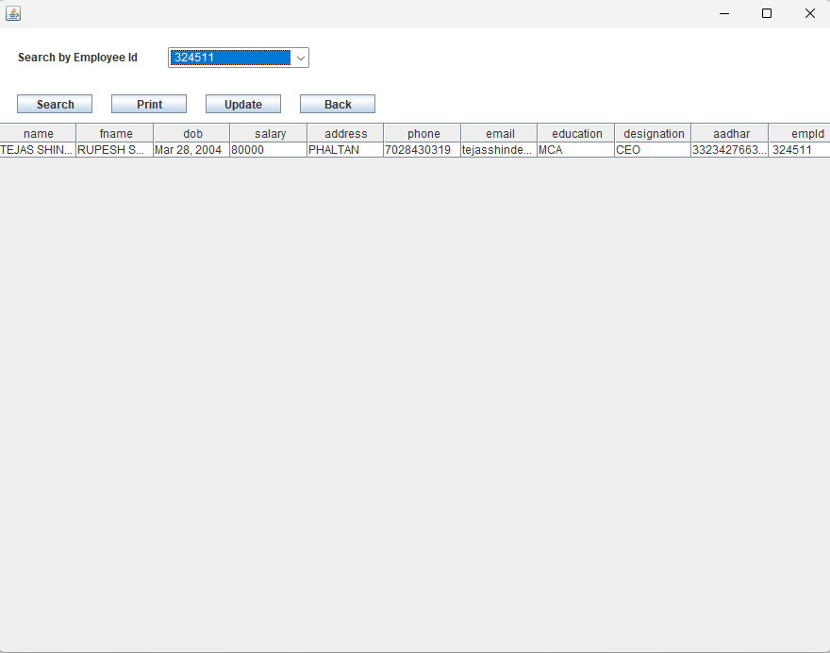
VIEW FORM

Slide 26
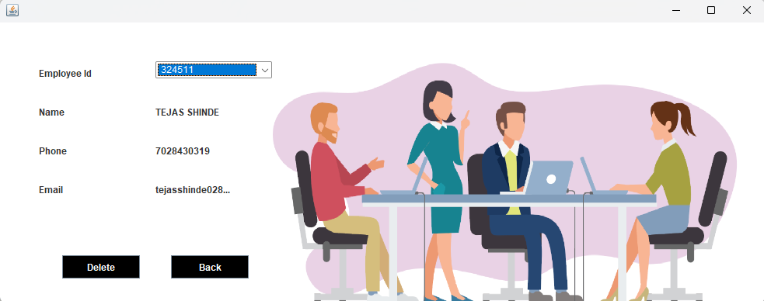
DELETE FORM

Slide 27
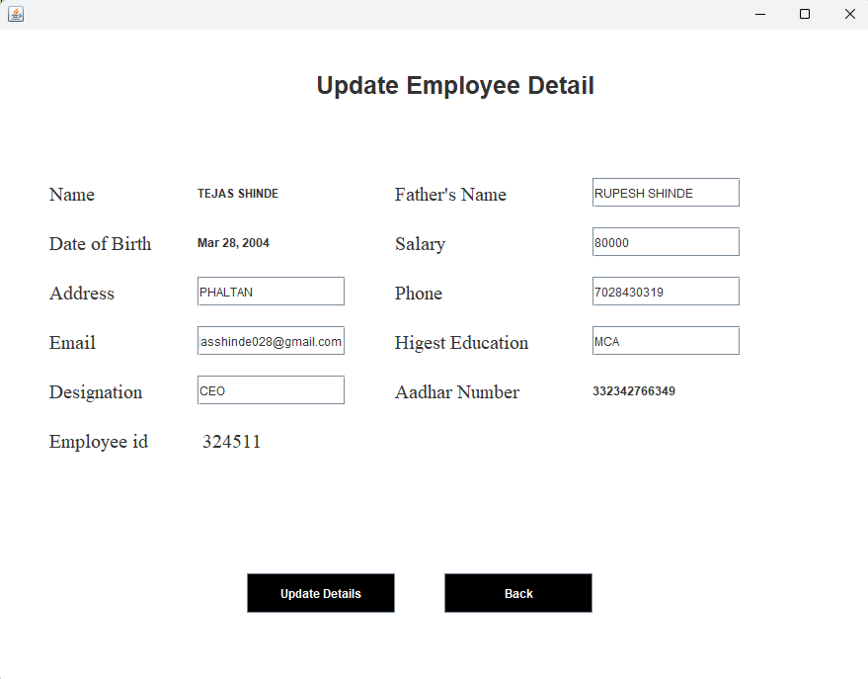
UPDATE FORM

